Slide 1
Algorithm Efficiency
Chapter 10
Data Structures and Problem Solving with C++: Walls and Mirrors, Carrano and Henry, © 2013

Slide 2
Contents
What Is a Good Solution?
Measuring the Efficiency of Algorithms
Data Structures and Problem Solving with C++: Walls and Mirrors, Carrano and Henry, © 2013

Slide 3
What Is a Good Solution?
Criterion
A solution is good if the total cost it incurs over all phases of its life is minimal.
Keep in mind, efficiency is only one aspect of a solution’s cost
Note: Relative importance of various components of a solution’s cost has changed since early days of computing.
Data Structures and Problem Solving with C++: Walls and Mirrors, Carrano and Henry, © 2013

Slide 4
Measuring Efficiency of Algorithms
Comparison of algorithms should focus on significant differences in efficiency
Difficulties with comparing programs instead of algorithms
  How are the algorithms coded?
  What computer should you use?
  What data should the programs use?
Data Structures and Problem Solving with C++: Walls and Mirrors, Carrano and Henry, © 2013

Slide 5
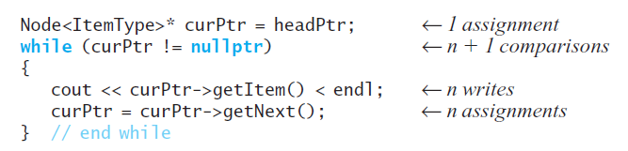
Execution Time of Algorithm
Traversal of linked nodes – example:
Displaying data in linked chain of n nodes requires time proportional to n
Data Structures and Problem Solving with C++: Walls and Mirrors, Carrano and Henry, © 2013

Slide 6
Algorithm Growth Rates
Measure algorithm’s time requirement as a function of problem size
Compare algorithm efficiencies for large problems
Look only at significant differences.
Data Structures and Problem Solving with C++: Walls and Mirrors, Carrano and Henry, © 2013

Slide 7
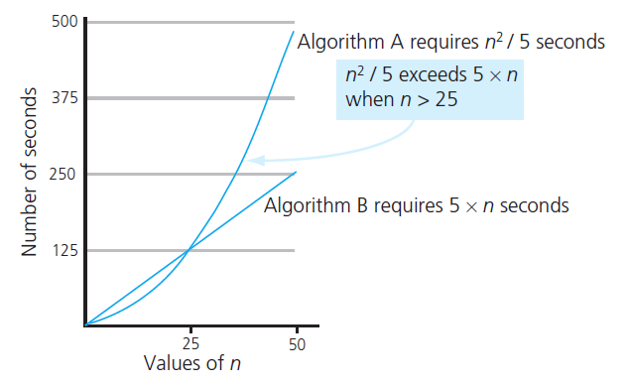
Algorithm Growth Rates
FIGURE 10-1 Time requirements
as a function of the problem size n
Data Structures and Problem Solving with C++: Walls and Mirrors, Carrano and Henry, © 2013

Slide 8
Analysis and Big O Notation
Definition:
  Algorithm A is order f ( n )
    Denoted O( f ( n ))
  If constants k and n₀ exist
  Such that A requires no more than k × f ( n ) time units to solve a problem of size n ≥ n₀ .
Data Structures and Problem Solving with C++: Walls and Mirrors, Carrano and Henry, © 2013

Slide 9
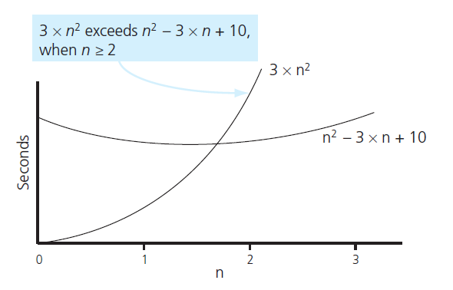
Analysis and Big O Notation
FIGURE 10-2 The graphs of 3 × n² and n² - 3 × n + 10
Data Structures and Problem Solving with C++: Walls and Mirrors, Carrano and Henry, © 2013

Slide 10
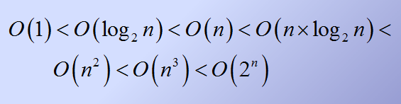
Analysis and Big O Notation
Order of growth of some common functions
Data Structures and Problem Solving with C++: Walls and Mirrors, Carrano and Henry, © 2013

Slide 11
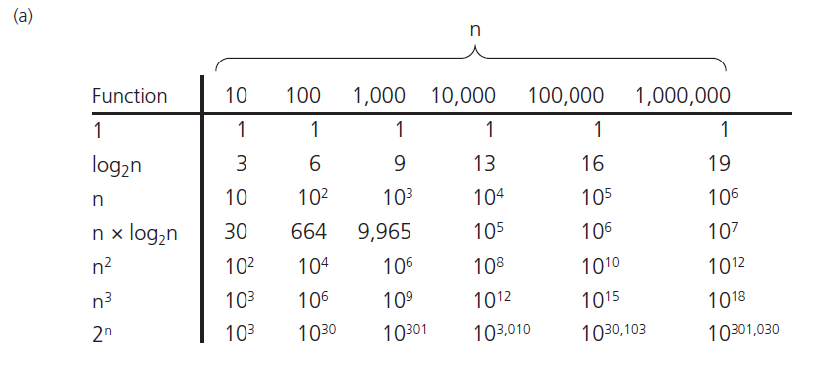
Analysis and Big O Notation
FIGURE 10-3 A comparison of growth-rate functions:
(a) in tabular form
Data Structures and Problem Solving with C++: Walls and Mirrors, Carrano and Henry, © 2013

Slide 12
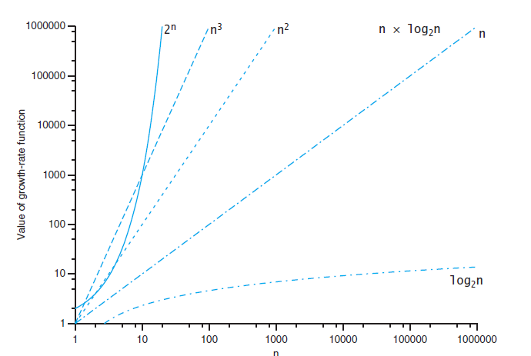
Analysis and Big O Notation
FIGURE 10-3 A comparison of growth-rate functions:
(a) in graphical form
Data Structures and Problem Solving with C++: Walls and Mirrors, Carrano and Henry, © 2013

Slide 13
Properties of Growth-Rate Functions
Ignore low-order terms
Ignore a multiplicative constant in the high-order term
O(f(n)) + O(g(n)) = O(f(n) + g(n))
Be aware of worst case, average case
Data Structures and Problem Solving with C++: Walls and Mirrors, Carrano and Henry, © 2013

Slide 14
Keeping Your Perspective
Array-based getEntry is O(1)
Link-based getEntry is O(n)
Consider how frequently particular ADT operations occur in given application
Some seldom-used but critical operations must be efficient
Data Structures and Problem Solving with C++: Walls and Mirrors, Carrano and Henry, © 2013

Slide 15
Keeping Your Perspective
If problem size always small, ignore an algorithm’s efficiency
Weigh trade-offs between algorithm’s time and memory requirements
Compare algorithms for both style and efficiency
Data Structures and Problem Solving with C++: Walls and Mirrors, Carrano and Henry, © 2013

Slide 16
Efficiency of Searching Algorithms
Sequential search
  Worst case O(n)
  Average case O(n)
  Best case O(1)
Binary search of sorted array
  Worst case O(log₂n)
  Remember required overhead for keeping array sorted
Data Structures and Problem Solving with C++: Walls and Mirrors, Carrano and Henry, © 2013

Slide 17
End
Chapter 10
Data Structures and Problem Solving with C++: Walls and Mirrors, Carrano and Henry, © 2013

